Slide 1
CS162 Operating Systems and Systems Programming Lecture 3 Processes (cont’d), Fork
January 22nd, 2018
Profs. Anthony D. Joseph and Jonathan Ragan-Kelley
http://cs162.eecs.Berkeley.edu

Slide 2
Recall: Four fundamental OS concepts
Thread
Single unique execution context
Program Counter, Registers, Execution Flags, Stack
Address Space w/ translation
Programs execute in an address space that is distinct from the memory space of the physical machine
Process
An instance of an executing program is a process consisting of an address space and one or more threads of control
Dual Mode operation/Protection
Only the “system” has the ability to access certain resources
The OS and the hardware are protected from user programs and user programs are isolated from one another by controlling the translation from program virtual addresses to machine physical addresses

Slide 3
Recall: 3 types of Mode Transfer
Syscall
Process requests a system service, e.g., exit
Like a function call, but “outside” the process
Does not have the address of the system function to call
Like a Remote Procedure Call (RPC) – for later
Marshall the syscall id and args in registers and exec syscall
Interrupt
External asynchronous event triggers context switch
e. g., Timer, I/O device
Independent of user process
Trap or Exception
Internal synchronous event in process triggers context switch
e.g., Protection violation (segmentation fault), Divide by zero, …
All 3 are an UNPROGRAMMED CONTROL TRANSFER
Where does it go?

Slide 4
How do we get the system target address of the “unprogrammed control transfer?”
Notes:
So how do we figure out where we want to jump when we don’t have the address of the code we’re jumping to?

Slide 5
Interrupt Vector
Address and properties of each interrupt handler
interrupt number (i)
intrpHandler_i () {
….
}
Where else do you see this dispatch pattern?
Notes:
Simple way: a table.
What we’ll call the interrupt vector.
This is just a table of addresses for the code, in the kernel, for the handler for each different kind of interrupt.
So we’ll have a unique number or ID for each kind of interrupt—IO interrupts like from the keyboard input, timer interrupts.
- Where else?
We’ll also see this same idea with system calls.
You’ll say “I want to do system call 5,” and the kernel will look up the corresponding system call handler in its own code.
This mechanism means that processes don’t have to know the addresses of code in the kernel.
That’s good for a bunch of reasons!
- modularity, portability, flexibility
- security

Slide 6
Simple B&B: User => Kernel
0000…
Proc 1
Proc 2
Proc n
code
…
Static Data
OS
heap
stack
sysmode
0
1000…
code
Base
1000 …
0000…
Static Data
Bound
1100…
FFFF…
heap
uPC
xxxx…
stack
1100…
PC
0000 1234
code
3000…
regs
00FF…
Static Data
How to return to system?
…
heap
stack
3080…
FFFF…
Notes:
So coming back to the example that we saw last time,
Imagine we're in Process 2 here.
So our base and bound registers are set to only see Process 2's address space.
And we're executing some code in that address space.
- Now imagine we take an interrupt. How do we pass control to the system?

Slide 7
Simple B&B: Interrupt
0000…
Proc 1
Proc 2
Proc n
code
…
Static Data
OS
heap
stack
sysmode
1
1000…
code
Base
1000 …
0000…
Static Data
Bound
1100 …
FFFF…
heap
uPC
0000 1234
stack
1100…
PC
IntrpVector[i]
code
3000…
regs
00FF…
Static Data
How to save registers and set up system stack?
…
heap
stack
3080…
FFFF…
Notes:
We've switched the system mode bit from user mode to system mode,
and the program counter now points to the interrupt handler for this interrupt inside the kernel's code.
We want to start running that handler, but…
- How do we set up a stack for the system to do its work?

Slide 8
Simple B&B: Save state
0000…
Proc 1
Proc 2
Proc n
code
…
Static Data
OS
heap
stack
sysmode
1
1000…
1000 …
code
Base
0000…
Static Data
1100 …
Bound
FFFF…
heap
0000 1234
uPC
regs
stack
1100…
PC
IntrpVector[i]
00FF…
code
3000…
Static Data
How to save registers and set up system stack?
…
heap
stack
3080…
FFFF…
Notes:
What we're going to do is allocate a piece of memory in the kernel's address space for storing this process's state.
now the system can use the machine…

Slide 9
Process Control Block
(Assume single threaded processes for now)
Kernel represents each process as a process control block (PCB)
Status (running, ready, blocked, …)
Registers, SP, … (when not running)
Process ID (PID), User, Executable, Priority, …
Execution time, …
Memory space, translation tables, …
Kernel Scheduler maintains a data structure containing the PCBs
Scheduling algorithm selects the next one to run

Slide 10
Recall: give the illusion of multiple processors?
vCPU1
vCPU2
vCPU3
vCPU1
vCPU2
vCPU3
vCPU1
vCPU2
Shared Memory
Time
Assume a single processor. How do we provide the illusion of multiple processors?
Multiplex in time!
Multiple “virtual CPUs”
Each virtual “CPU” needs a structure to hold, i.e., PCB:
Program Counter (PC), Stack Pointer (SP)
Registers (Integer, Floating point, others…?)
How switch from one virtual CPU to the next?
Save PC, SP, and registers in current PCB
Load PC, SP, and registers from new PCB
What triggers switch?
Timer, voluntary yield, I/O, other things

Slide 11
Simple B&B: Switch User Process
0000…
Proc 1
Proc 2
Proc n
code
RTU
…
Static Data
OS
heap
stack
sysmode
1
1000…
3000 …
code
Base
3000 …
0000…
Static Data
0080 …
Bound
0080 …
FFFF…
heap
0000 0248
uPC
0000 0248
regs
stack
1100…
PC
0001 0124
00D0…
code
3000…
regs
00D0…
Static Data
…
heap
stack
3080…
FFFF…
Notes:
So back to our example, now let’s say what we decide to do in the kernel is switch the user process we’re running…
To do that we're going to take the state information from the process control block for process 1
load the state into the machine
And then call the Return To User instruction
That’s going to…

Slide 12
Simple B&B: “resume”
0000…
Proc 1
Proc 2
Proc n
code
…
Static Data
OS
heap
stack
sysmode
0
1000…
code
Base
3000 …
0000…
Static Data
Bound
0080 …
FFFF…
heap
uPC
xxxx xxxx
stack
1100…
PC
000 0248
code
3000…
regs
00D0…
Static Data
…
heap
stack
3080…
FFFF…
Notes:
…hand control all the way back to the process.
exit from system to user mode,
and swap the program counter—the pointer to the actual code the processor is executing—back to the last place we left off in process 1

Slide 13
CPU, Processor, Core, Process, Thread?!?
CPU/Processor
Process
Core
Core
Thread
CPU/Processor
Process
Core
Core
Thread
Thread
Thread
Hardware
Software
Notes:
HW vs. Software
The hardware terms we use aren’t totally consistent or precise.
Roughly…
But you will also hear us use “processor” or CPU to refer to a single core.

Slide 14
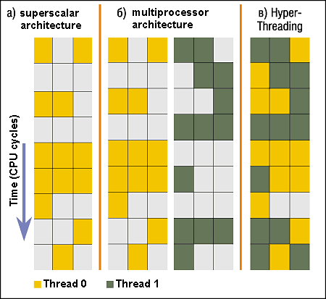
Simultaneous MultiThreading/Hyperthreading
Hardware technique
Superscalar processors can execute multiple instructions that are independent
Hyperthreading duplicates register state to make a second “thread,” allowing more instructions to run
Can schedule each thread as if were separate CPU
But, sub-linear speedup!
Original technique called “Simultaneous Multithreading”
http://www.cs.washington.edu/research/smt/index.html
SPARC, Pentium 4/Xeon (“Hyperthreading”), Power 5
Colored blocks show
instructions executed
Notes:
Intel seems to be discarding SMT in Silvermont because of power problems

Slide 15
Scheduler
if ( readyProcesses(PCBs) ) {
nextPCB = selectProcess(PCBs);
run( nextPCB );
} else {
run_idle_process();
}
Scheduling: Mechanism for deciding which processes/threads receive the CPU
Lots of different scheduling policies provide …
Fairness or
Real-time guarantees or
Latency optimization or ..
Notes:
Next concept…
All the way in the Core of OS is an infinite loop
That decides what to run at any given time.

Slide 16
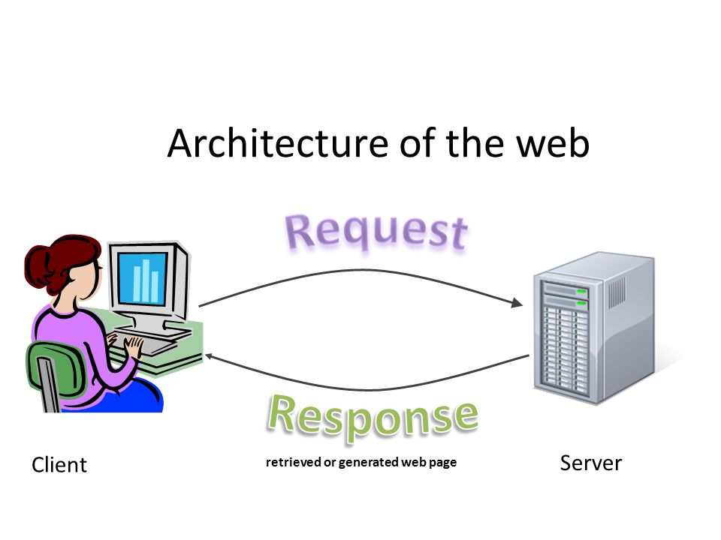
Putting it together: web server
Request
Reply
(retrieved by web server)
Client
Web Server

Slide 17
Putting it together: web server
Server
4. parse request
9. format reply
request
buffer
reply
buffer
network
socket
read
3. kernel
copy
10. network
socket
write
5. file
read
8. kernel
copy
syscall
syscall
Kernel
wait
RTU
11. kernel copy
from user buffer
to network buffer
RTU
interrupt
interrupt
2. copy arriving
packet (DMA)
12. format outgoing
packet and DMA
6. disk
request
7. disk data
(DMA)
Hardware
Network
interface
Disk interface
Request
Reply

Slide 18
Recall: 3 types of Kernel Mode Transfer
Syscall
Process requests a system service, e.g., exit
Like a function call, but “outside” the process
Does not have the address of the system function to call
Like a Remote Procedure Call (RPC) – for later
Marshall the syscall ID and arguments in registers and execute syscall
Interrupt
External asynchronous event triggers context switch
e.g., Timer, I/O device
Independent of user process
Trap or Exception
Internal synchronous event in process triggers context switch
e.g., Protection violation (segmentation fault), Divide by zero, …

Slide 19
Recall: User/Kernel (Privileged) Mode
User Mode
interrupt
exception
syscall
rtn
rfi
Kernel Mode
exit
exec
Limited HW access
Full HW access
Notes:
In the lifecycle of a process…

Slide 20
Implementing Safe Kernel Mode Transfers
Important aspects:
Separate kernel stack
Controlled transfer into kernel (e.g., syscall table)
Carefully constructed kernel code packs up the user process state and sets it aside
Details depend on the machine architecture
Should be impossible for buggy or malicious user program to cause the kernel to corrupt itself

Slide 21
Need for Separate Kernel Stacks
Kernel needs space to work
Cannot put anything on the user stack (Why?)
Two-stack model
OS thread has interrupt stack (located in kernel memory) plus User stack (located in user memory)
Syscall handler copies user args to kernel space before invoking specific function (e.g., open)
Interrupts (???)
Notes:
…now for interrupts, it’s similar but a little different because it’s occurring asynchronously.

Slide 22
Before interrupt
Notes:
So here, we’re just running user code as normal.
And suddenly we take an interrupt.

Slide 23
During interrupt
Notes:
That switches control to the interrupt handler, which has to save the user state before it can handle the interrupt.

Slide 24
Kernel System Call Handler
Vector through well-defined syscall entry points!
Table mapping system call number to handler
Locate arguments
In registers or on user (!) stack
Copy arguments
From user memory into kernel memory
Protect kernel from malicious code evading checks
Validate arguments
Protect kernel from errors in user code
Copy results back
Into user memory
Notes:
Why copy?
Time of use / time of check – imagine process has another thread running at the same time. It’s also got access to the user stack of this thread, since it’s in the same process. So they could modify the values while the kernel is working with them!
Imagine I’m reading a file. What if I open a file I have rights to, then during the call to open it I change the requested file to point to the password file!

Slide 25
Hardware support: Interrupt Control
Interrupt processing not visible to the user process:
Occurs between instructions, restarted transparently
No change to process state
What can be observed even with perfect interrupt processing?
Interrupt Handler invoked with interrupts ‘disabled’
Re-enabled upon completion
Non-blocking (run to completion, no waits)
Pack up in a queue and pass off to an OS thread for hard work
wake up an existing OS thread
Notes:
Now for interrupts, the hardware gives us various kinds of support.
Remember: interrupts are asynchronous—they can occur at any time.

Slide 26
Hardware support: Interrupt Control
OS kernel may enable/disable interrupts
On x86: CLI (disable interrupts), STI (enable)
Atomic section when select next process/thread to run
Atomic return from interrupt or syscall
HW may have multiple levels of interrupt
Mask off (disable) certain interrupts, eg., lower priority
Certain Non-Maskable-Interrupts (NMI)
e.g., kernel segmentation fault
Notes:
The OS kernel can separately choose to enable & disable interrupts.
This lets us do things atomically.
We also get atomicity when returning from kernel handlers.

Slide 27
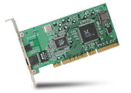
Interrupt Controller
Interrupt Mask
Priority Encoder
IntID
CPU
Interrupt
Int Disable
Timer
Software
Interrupt
Control
NMI
Network
Interrupts invoked with interrupt lines from devices
Interrupt controller chooses interrupt request to honor
Mask enables/disables interrupts
Priority encoder picks highest enabled interrupt
Software Interrupt Set/Cleared by Software
Interrupt identity specified with ID line
CPU can disable all interrupts with internal flag
Non-Maskable Interrupt line (NMI) can’t be disabled
Notes:
Graphically, this is what it looks like.
We have multiple interrupt lines from devices, and other sources (timers, software interrupts)
All this comes through the interrupt controller

Slide 28
How do we take interrupts safely?
Interrupt vector
Limited number of entry points into kernel
Kernel interrupt stack
Handler works regardless of state of user code
Interrupt masking
Handler is non-blocking
Atomic transfer of control
“Single instruction”-like to change:
Program counter
Stack pointer
Memory protection
Kernel/user mode
Transparent restartable execution
User program does not know interrupt occurred
Notes:
So: how do we take interrupts safely?
(Mostly like syscalls, plus need for atomicity)
Just like with system call interface, we have an interrupt vector – a table that indirects between different types of interrupts, and the code that

Slide 29
Administrivia: Getting started
THIS Friday (1/26) is early drop day! Very hard to drop afterwards…
Get working on Homework 0 due on Monday by 11:59PM!
Get familiar with all the cs162 tools
Submit to autograder via git
Participation: Attend section! Get to know your TA!
Group sign up: now via autograder, then TA form (next week, after EDD)
Get finding groups of 4 people ASAP
Priority for same section; if cannot make this work, keep same TA
Notes:
Group sign up: everyone in a group has to sign up in the autograder
THEN we’ll post a form that will let you sign up as a group (probably next week, after the drop deadline)
Groups: ideally 4 people
And ideally in the same section—we’ll give priority to groups where everyone is in the same section.
QUESTIONS?

